Slide 1
ONLINE BOOK STORE
Team Members:
Shreyanka Agarwal
Anjali Sharma
Mentor :Prabu Ganesh
Notes:
Add instructor notes here.

Slide 2
OBJECTIVES
Project Understanding
Approach used
Project Execution
Modules
Learning
Best Practices
Opportunity for improvement
Notes:
Add instructor notes here.

Slide 3
PROJECT UNDERSTANDING
The main objective of this project is to design and develop a website that allows their customer to order the books they want while sitting at home.
In Online Book Store , the company needs to maintain a group of people who put book information on the website and manages customer's information along with the orders.
The Online Book Store System is used to Order the book by searching the book by its category or they can search book by providing a specific keyword.

Slide 4
High Level Design Diagram
Controller
Microservice
User Interface
Controller
Service
Dao
Database

Slide 5
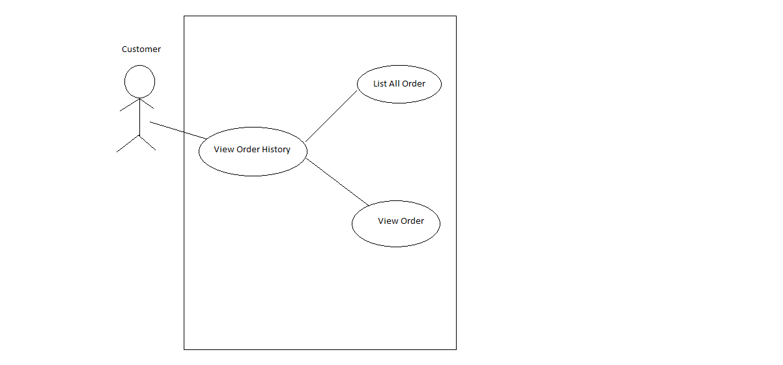
USE CASE DIAGRAM

Slide 6
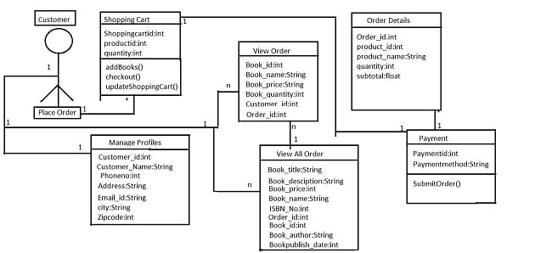
CLASS DIAGRAM

Slide 7
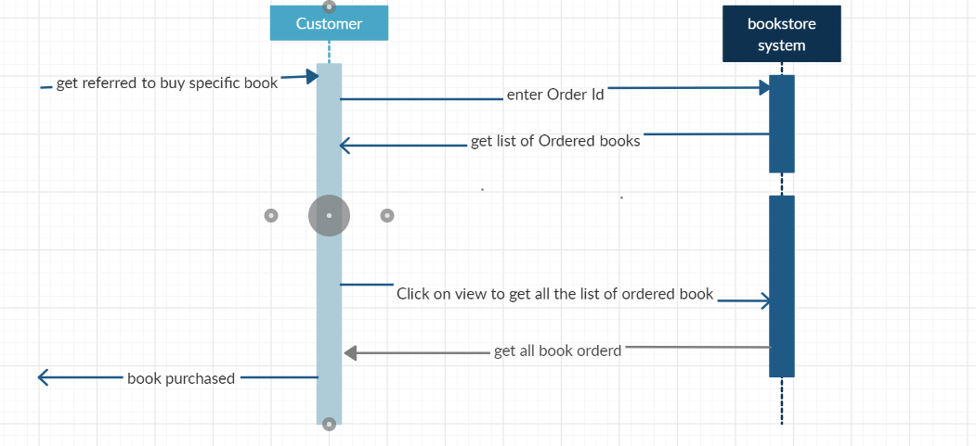
SEQUENCE DIAGRAM FOR VIEW HISTORY OF BOOKS

Slide 8
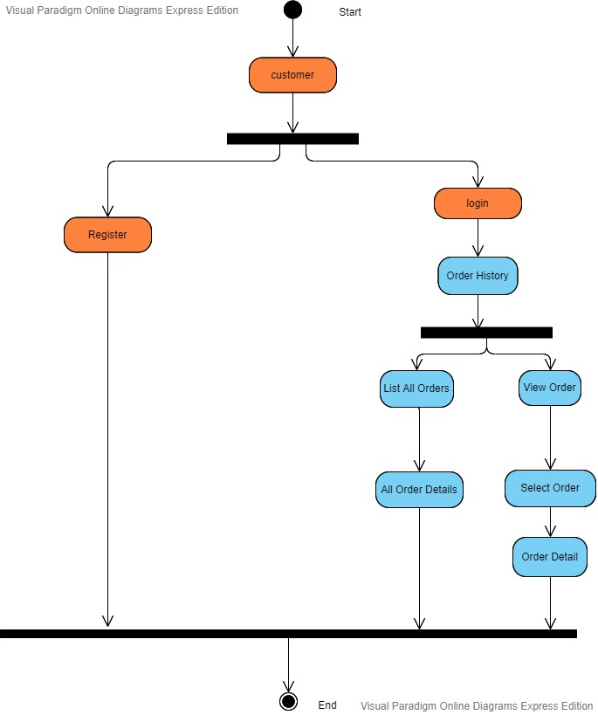
ACTIVITY DIAGRAM

Slide 9
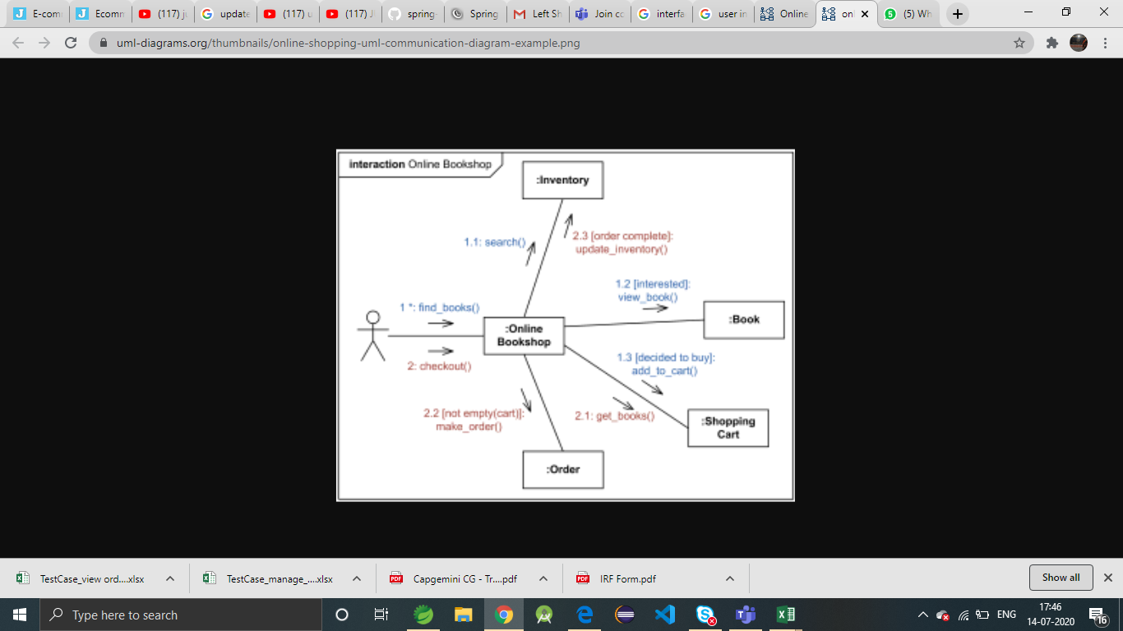
INTERFACE DIAGRAM

Slide 10
APPROACH USED
Business Logic Components and Services :-
-Spring Boot
-Microservices
Databases:-
-Oracle SQL
-MySQL(cloud)

Slide 11
PROJECT EXECUTION
View Order History:
> View Orders
> List all orders

Slide 12
VIEW ORDER MODULE
Customer can login into the portal through his/her login credentials.
Customer can view his/her order details.
Customer can also view his/her list of all the orders.

Slide 13
THANK YOU

